Slide 1
Behavioral Patterns
JS Patterns and Anti Patterns
Malte Brockmann, Jun Heui Cho

Slide 2
Outline
Behavior Pattern in general
Command
Memento
Patterns and Anti Patterns - Behavioral Patterns - Malte Brockmann, Jun Heui Cho - WS 2015

Slide 3
Behavior Pattern in general
Mainly concerned with the communication between objects.
Chain of responsibility
Command
Interpreter
Iterator
Mediator
Memento
Null Object
Observer
State
Strategy
Template method
Visitor
Patterns and Anti Patterns - Behavioral Patterns - Malte Brockmann, Jun Heui Cho - WS 2015

Slide 4
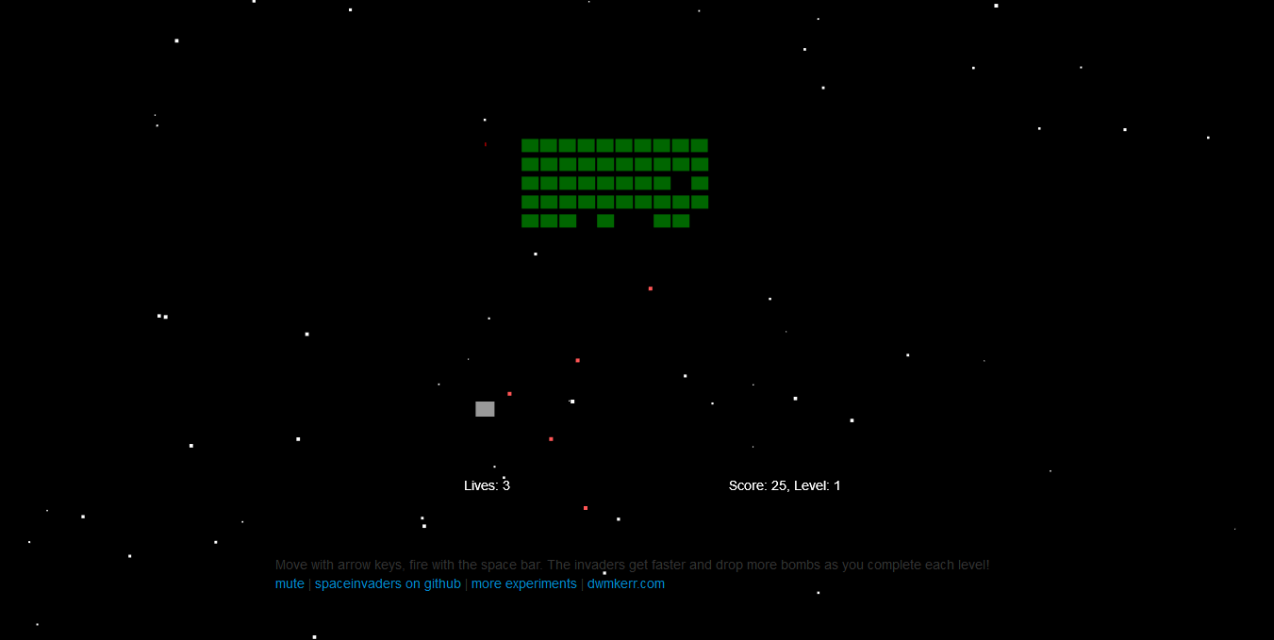
Spaceinvader
Retro Game: shooting Spaceinvader
Level bases
State bases (Welcome-, GameOver-, PlayState, ect.)
Patterns and Anti Patterns - Behavioral Patterns - Malte Brockmann, Jun Heui Cho - WS 2015

Slide 5
Command
Encapsualte a request as an Object
Request without knowing anything about the operation being requestet. - “Black box execute()”
Uses: GUI buttons, Networking, Multi-level undo, Progress bar
Patterns and Anti Patterns - Behavioral Patterns - Malte Brockmann, Jun Heui Cho - WS 2015

Slide 6
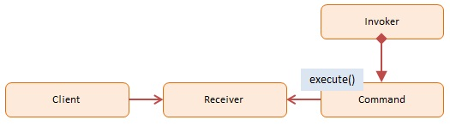
Command - Participans
Client: decides which command at which point
Receiver: knows how to carry out the operatoin
Command: execute()
Invoker: knows how to execute
http://www.dofactory.com/images/diagrams/javascript/javascript-command.jpg
Patterns and Anti Patterns - Behavioral Patterns - Malte Brockmann, Jun Heui Cho - WS 2015

Slide 7
Command - Spaceinvader 1/4
Before:
if(game.pressedKeys[37]) {
this.ship.x -= this.shipSpeed * dt;
}
if(game.pressedKeys[39]) {
this.ship.x += this.shipSpeed * dt;
}
if(game.pressedKeys[32]) {
this.fireRocket();
}
[…]
bomb.y += dt * bomb.velocity;
[…]
rocket.y -= dt * rocket.velocity;
Patterns and Anti Patterns - Behavioral Patterns - Malte Brockmann, Jun Heui Cho - WS 2015

Slide 8
Command - Spaceinvader 2/4
after:
var goLeft = {
execute : function(obj, speed) {
obj.x -= speed * dt;
}
}
var goRight = {
execute : function(obj, speed) {
obj.x += speed * dt;
}
}
var shoot = {
execute : function(obj) {
obj.fireRocket();
}
}
Patterns and Anti Patterns - Behavioral Patterns - Malte Brockmann, Jun Heui Cho - WS 2015

Slide 9
Command - Spaceinvader 3/4
after:
var goUp = {
execute : function(obj, speed) {
obj.y -= speed * dt;
}
}
var goDown = {
execute : function(obj, speed) {
obj.y += speed * dt;
}
}
Patterns and Anti Patterns - Behavioral Patterns - Malte Brockmann, Jun Heui Cho - WS 2015

Slide 10
Command - Spaceinvader 4/4
after:
if(game.pressedKeys[37]) {
goLeft.execute(this.ship, this.shipSpeed);
}
if(game.pressedKeys[39]) {
goRight.execute(this.ship, this.shipSpeed);
}
if(game.pressedKeys[32]) {
shoot.execute(this);
}
[…]
goDown.execute(bomb, bomb.velocity);
[…]
goUp.execute(rocket, rocket.velocity);
Patterns and Anti Patterns - Behavioral Patterns - Malte Brockmann, Jun Heui Cho - WS 2015

Slide 11
Memento
Capturing and externalizing an object’s internal state to be restored later.
Database for “save point”
Use: used to avoid disclosure of implemetnation details
Patterns and Anti Patterns - Behavioral Patterns - Malte Brockmann, Jun Heui Cho - WS 2015

Slide 12
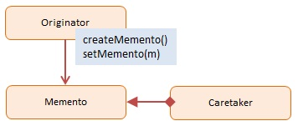
Memento - Participans
Originator: Interface to create and restore mementos
Memento: Ordinator object
Caretaker: stores mementos
http://www.dofactory.com/images/diagrams/javascript/javascript-memento.jpg
Patterns and Anti Patterns - Behavioral Patterns - Malte Brockmann, Jun Heui Cho - WS 2015

Slide 13
Memento - Spaceinvader 1/3
before:
WelcomeState.prototype.keyDown = function(game, keyCode) {
[…]
game.moveToState(new LevelIntroState(game.level));
};
[…]
GameOverState.prototype.keyDown = function(game, keyCode) […]
game.moveToState(new LevelIntroState(1));
}
Patterns and Anti Patterns - Behavioral Patterns - Malte Brockmann, Jun Heui Cho - WS 2015

Slide 14
Memento - Spaceinvader 2/3
after:
function Memento(state){
this.state = state;
this.getSavedState = function(){
return this.state;
};
};
function Caretaker(){
var saveState = [];
this.addMemento = function(memento){
saveState.push(memento);
};
this.getMemento = function(index){
return saveState[index];
};
};
Patterns and Anti Patterns - Behavioral Patterns - Malte Brockmann, Jun Heui Cho - WS 2015

Slide 15
Memento - Spaceinvader 3/3
after:
caretaker = new Caretaker();
[…]
WelcomeState.prototype.keyDown = function(game, keyCode) {
[…]
caretaker.addMemento(new Memento(new LevelIntroState(game.level))); game.moveToState((caretaker.getMemento(0)).getSavedState())
}
};
[…]
GameOverState.prototype.keyDown = function(game, keyCode) {
[…]
game.moveToState((caretaker.getMemento(0)).getSavedState());
}
};
Patterns and Anti Patterns - Behavioral Patterns - Malte Brockmann, Jun Heui Cho - WS 2015

Slide 16
Chain of responsibility
Avoid coupling the sender of a request to its receiver.
More than one object have the chance to handle the request.
linear search for a handler
Patterns and Anti Patterns - Behavioral Patterns - Malte Brockmann, Jun Heui Cho - WS 2015

Slide 17

Chain of responsibility - Participants
Client: Initiator of the request
Handler: has an interface for handling the request
http://www.dofactory.com/images/diagrams/javascript/javascript-chain-of-responsibility.jpg
Patterns and Anti Patterns - Behavioral Patterns - Malte Brockmann, Jun Heui Cho - WS 2015

Slide 18
Chain of responsibility - Tic tac toe 1/4
before:
function checkWinner() {
if (checkRows() === true || checkCols() === true || checkDiag() === true) {
winningPlayer = turn.currentPlayerColor();
// Alert winner
endGame("Player " + winningPlayer + ", you win!");
}
else if (checkTie() === true) {
endGame("It's a tie...");
}
else {
turn.changeTurn();
}
}
Patterns and Anti Patterns - Behavioral Patterns - Malte Brockmann, Jun Heui Cho - WS 2015

Slide 19
Chain of responsibility - Tic tac toe 2/4
before:
function checkRows() {
for (i = 0; i < board.length; i++) {
var same = true;
for (j = 0; j < board[i].length; j++) {
if (board[i][j] === 0 || board[i][j] !== board[i][0]) {
same = false;
}
}
if (same) {
return same;
}
}
}
Patterns and Anti Patterns - Behavioral Patterns - Malte Brockmann, Jun Heui Cho - WS 2015

Slide 20
Chain of responsibility - Tic tac toe 3/4
after:
function checkWinner() {
checkRows();
}
Patterns and Anti Patterns - Behavioral Patterns - Malte Brockmann, Jun Heui Cho - WS 2015

Slide 21
Chain of responsibility - Tic tac toe 4/4
after:
function checkRows() {
for (i = 0; i < board.length; i++) {
var same = true;
for (j = 0; j < board[i].length; j++) {
if (board[i][j] === 0 || board[i][j] !== board[i][0]) {
same = false;
}
}
if (same) {
winningPlayer = turn.currentPlayerColor();
// Alert winner
endGame("Player " + winningPlayer + ", you win!");
}
}
checkCols();
}
Patterns and Anti Patterns - Behavioral Patterns - Malte Brockmann, Jun Heui Cho - WS 2015

Slide 22
Observer
Define a one-to-many dependency between objects
When one object (Observable) changes its state, all dependent objects (Observers) are notified (usually with a message)
Notified objects handle their own update
Patterns and Anti Patterns - Behavioral Patterns - Malte Brockmann, Jun Heui Cho - WS 2015

Slide 23
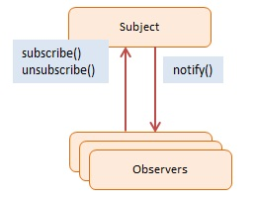
Observer - Participants
Subject / Observable: Maintains a list of observers, lets them subscribe/unsubscribe, and notifies them about changes
Observers: Has a function that can be invoked when notified
http://http://www.dofactory.com/images/diagrams/javascript/javascript-observer.jpg
Patterns and Anti Patterns - Behavioral Patterns - Malte Brockmann, Jun Heui Cho - WS 2015

Slide 24
Observer – Pac Man 1/5
before:
function startLevel() {
user.resetPosition();
for (var i = 0; i < ghosts.length; i += 1) {
ghosts[i].reset();
}
audio.play("start");
timerStart = tick;
setState(COUNTDOWN);
}
Patterns and Anti Patterns - Behavioral Patterns - Malte Brockmann, Jun Heui Cho - WS 2015

Slide 25
Observer – Pac Man 2/5
before:
function eatenPill() {
audio.play("eatpill");
timerStart = tick;
eatenCount = 0;
for (i = 0; i < ghosts.length; i += 1) {
ghosts[i].makeEatable(ctx);
}
};
Patterns and Anti Patterns - Behavioral Patterns - Malte Brockmann, Jun Heui Cho - WS 2015

Slide 26
Observer – Pac Man 3/5
after:
function startLevel() {
user.resetPosition();
notifyObservers("levelstarted");
timerStart = tick;
setState(COUNTDOWN);
}
[…]
function eatenPill() {
timerStart = tick;
eatenCount = 0;
notifyObservers("pilleaten");
};
Patterns and Anti Patterns - Behavioral Patterns - Malte Brockmann, Jun Heui Cho - WS 2015

Slide 27
Observer – Pac Man 4/5
after:
//REFACTOR: adding observable functionalities
function subscribe(o) {
observers.push(o);
};
function unsubscribe(o) {
observers = observers.filter(
function(item) {
if (item !== o) { return item; } }
); };
function notifyObservers(message) {
for (var i = observers.length - 1; i >= 0; i--) {
observers[i].notify(message);
}; };
Patterns and Anti Patterns - Behavioral Patterns - Malte Brockmann, Jun Heui Cho - WS 2015

Slide 28
Observer – Pac Man 5/5
after:
//REFACTOR: adding observer functionalities for Ghost
function notify(message) {
switch(message) {
case "levelstarted":
reset();
break;
case "pilleaten":
makeEatable();
break;
default:
break;
}
};
(Analog for Audio)
Patterns and Anti Patterns - Behavioral Patterns - Malte Brockmann, Jun Heui Cho - WS 2015

Slide 29
Sources
http://www.dofactory.com/javascript/design-patterns
https://sourcemaking.com/design_patterns
https://en.wikipedia.org/wiki/Command_pattern
https://de.wikipedia.org/wiki/Memento_%28Entwurfsmuster%29
(Osmani, A. (2012). Learning JavaScript Design Patterns. O'Reilly Media, Inc.)
Patterns and Anti Patterns - Behavioral Patterns - Malte Brockmann, Jun Heui Cho - WS 2015

